Slide 1

H.V.V.A. 3D Printing Solutions
BUSINESS INTELLIGENCE AND BUSINESS ANALYTICS

Slide 2
BACKGROUND OF THE COMPANY
It is a fictitious company which was started in 2017.
Past 2 years it was growing and expanding but operating on a small scale with on premises.
In 2017-19, they were serving 365-370 customers per year in Ireland.
They had business to business specific strategy.
They didn’t feel to use new generation software like Dynamic 365, Power BI, etc.
In 2017-19, net worth of the company was around € 1.7 million per year in revenue.

Slide 3
NEW THINGS ADDED IN 2019-20
Since, their revenue is growing so they have hired a professional team of four members in order to handle the entire company’s flow.
We have implemented Customer Relationship Management using Dynamic 365 sales hub for the company as well as migrated historical and legacy data to the cloud.
Large number of organizations provide cloud storage so we have used Amazon web service’s Relational database service PostgreSQL.
Dynamic 365 and PostgreSQL are integrated to migrate recent and upcoming data.
Data is migrated to cloud and then that data is loaded from cloud to PowerBI.

Slide 4
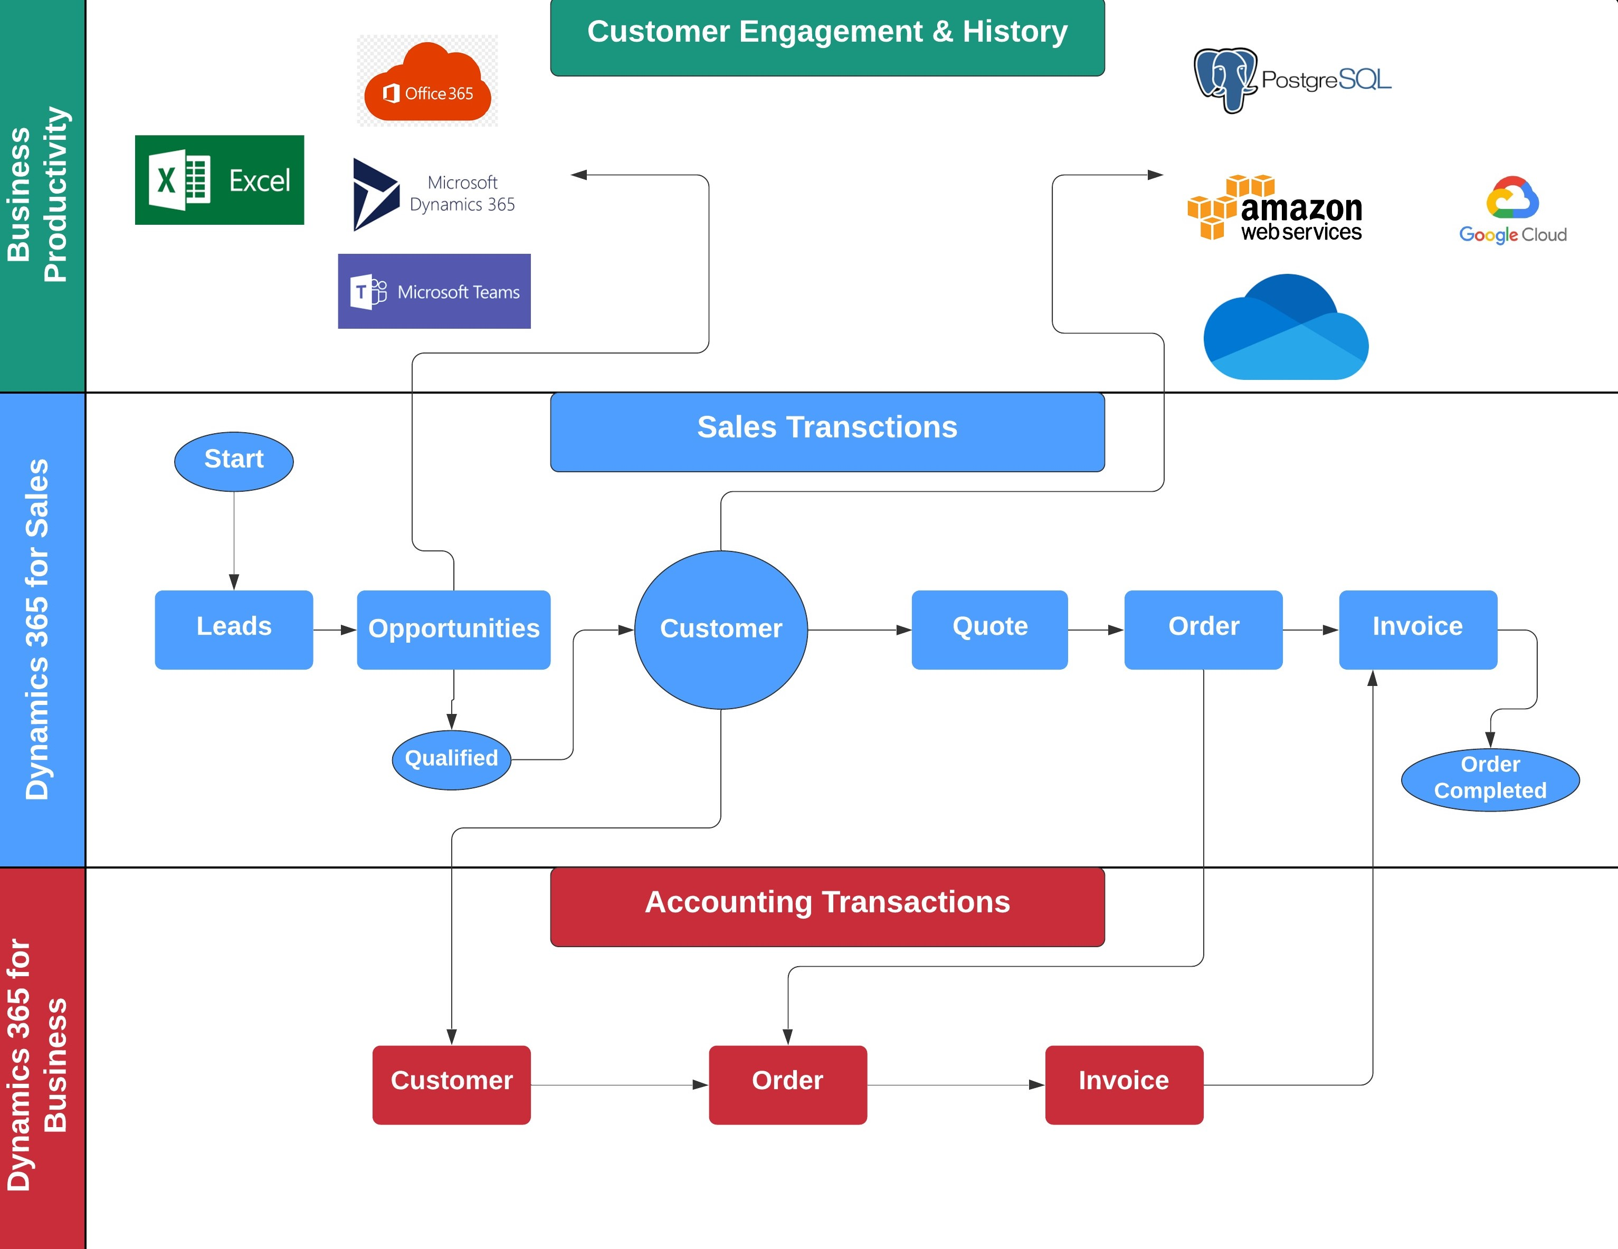
REPRESENTATION OF SOLUTIONS IMPLEMENTED

Slide 5
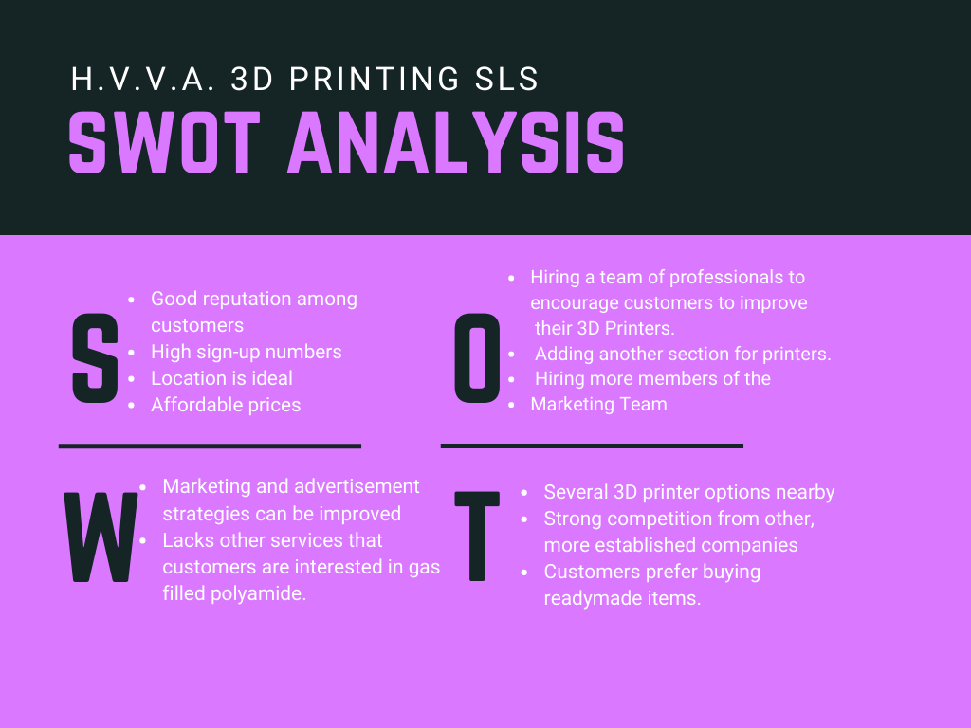
SWOT ANALYSIS
SWOT analysis is a key part of any business and strategic plan. SWOT stands for strengths, weaknesses, opportunities and threats. A SWOT analysis will help you identify the parts of your business that are doing well. These are your critical success factors aspects of your business that are strong and give you a competitive advantage recognizing these assets will help you continue on at a high level and you will need to find ways to leverage and build upon these strengths to grow your business.

Slide 6
NEED FOR ANALYTICS For our company, the data present must be treated as an asset. The key analytical requirements will be:
1.) Acquisition Costs
2.) Customer Retention
3.)Market Insights
Evaluating if rapid growth is affordable with the paid acquisition.
Unsustainable to keep losing profit under the appearance of growth.
Presents opinions about what strategies are acting and which ones are burning revenues.
Wasting too much on new customers with ROI.
One time customers symbolize the predicament with customer satisfaction.
Helps to come up with more favorable offers and plans to engage customers.
Helps to evaluate the market based on customer preferences.
Gives an impression about consumer ambitions and what products fascinate them.
Helps to form practical strategies to procure new customers and preserve old ones.

Slide 7
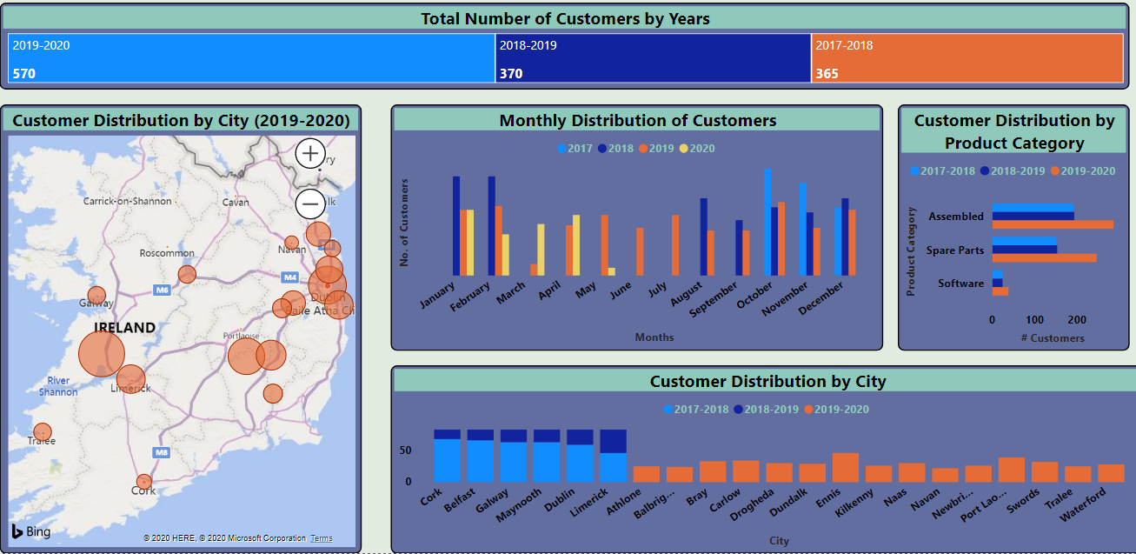
CUSTOMER STATISTICS

Slide 8
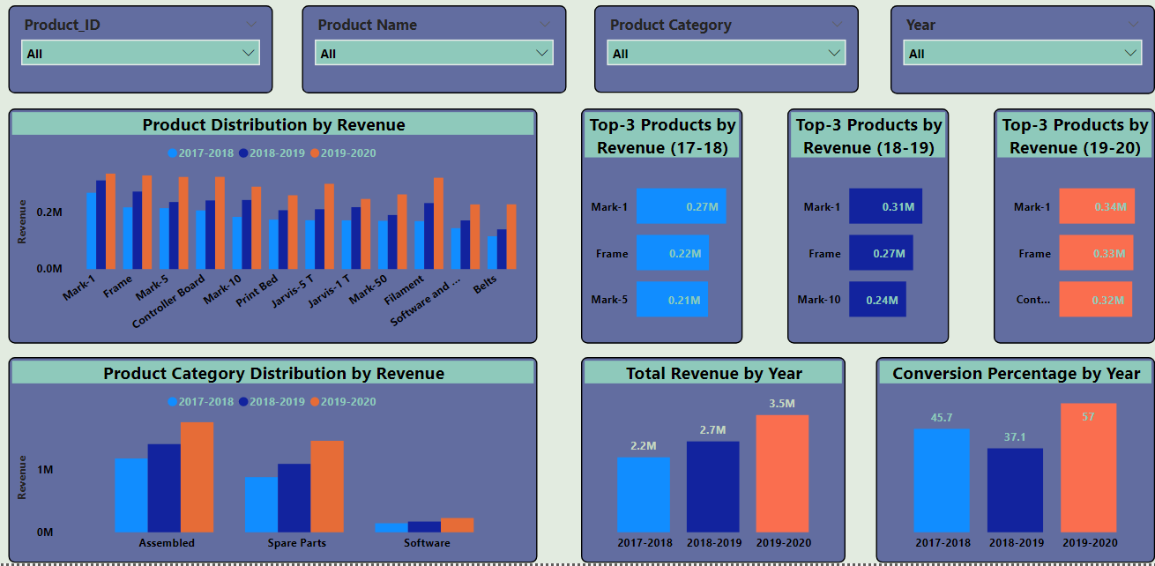
TREND STATISTICS

Slide 9
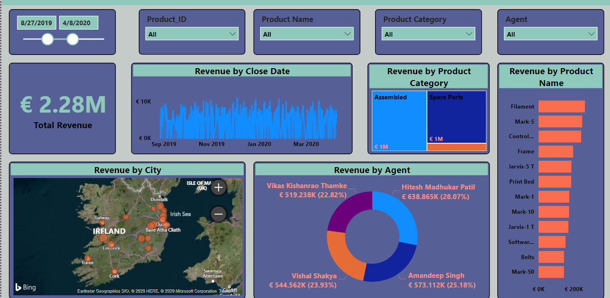
SALES STATISTICS

Slide 10
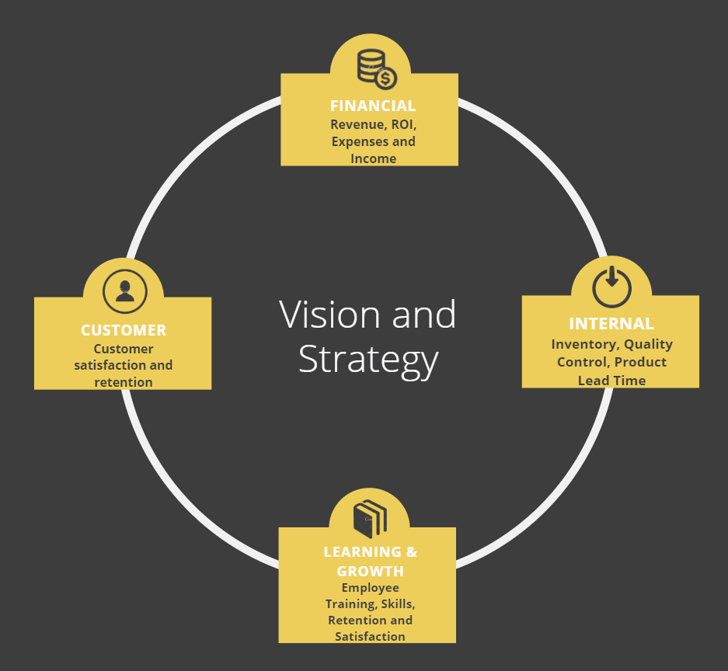
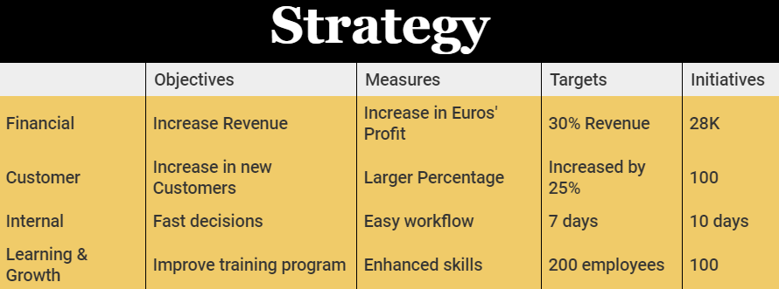
BALANCED SCORECARD

Slide 11
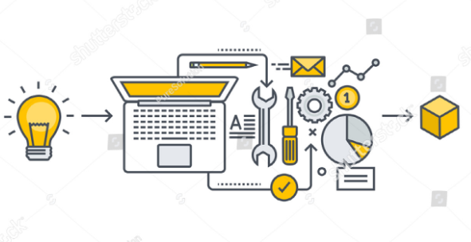

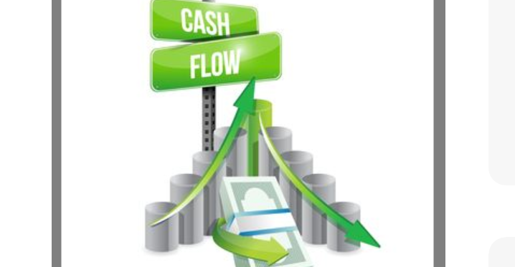
ADVANTAGES OF BUSINESS ANALYSIS
Revenue Flow
Product Development
Customer Behaviour
Product development typically refers to all of the stages involved in bringing a product from concept or idea, through market release and beyond
Consumer behavior is the study of consumers and the processes they use to choose, use (consume), and dispose of products and services, including consumers’ emotional, mental, and behavioral responses.
Revenue is the money a company earns from the sale of its products and services. Cash flow is the net amount of cash being transferred into and out of a company. Revenue provides a measure of the effectiveness of a company's sales and marketing, whereas cash flow is more of a liquidity indicator.

Slide 12




OUR TEAM
Hitesh Madhukar Patil
x19147996
Vikas Kishanrao Thamke
x19180080
Vishal Shakya
x19182732
Amandeep Singh
x19194137

Slide 13
THANK YOU!

